Slide 1
Sustainable Solutions for Complex Waters
IPA Removal System Options
Siva

Slide 2
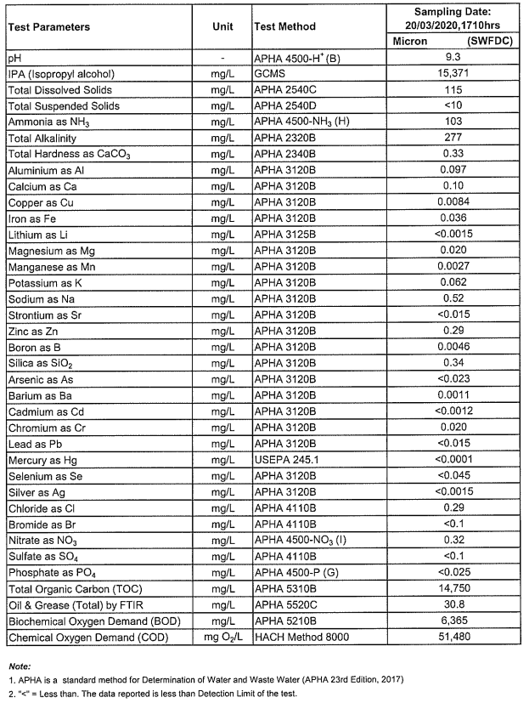
Case study
Effluent
Characteristics
Influent Wastewater Characteristics (4 m3/hr)
Treated Water: ~3.88 m³/hr (IPA <10 ppm)
IPA recovery: ~ 0.12 m³/hr (>85% purity )

Slide 3
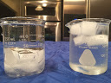
IPA/Water mixtures freezing point curve
ICE density 0.92
Micron WW stream contains 15371 mg/l of IPA
At low temperatures concentrated IPA will have higher density
Notes:
The increase in volume of ice is about 9%. This increase causes enough force to break most rigid containers. This is the same force, repeated on a daily basis, that creates "pot holes" in the roads in the winter time.

Slide 4
Flow Scheme Option 1 – Low temperature crystallization
Polishing
COD/TOC analyzer
Influent
Recovered Water
UF
LT Reactor
AC
Recovered IPA
LT Reactor – Low Temperature crystallization (-4C)*
AC - Alcohol Concentrator (RO)
Polishing – RO and wash with permeate
IPA – Isopropyl Alcohol
*Theoretically -4C is enough, planning to perform freezing tests to validate the temperature.

Slide 5
Process Description – Single/Double stage IPA Con.
Pre-cool the WW stream using plate frame/shell & tube HXs to a desired temperature.
Reactor should maintain the temperature below the theoretical value (-4C)
Based on the density the IPA and Ice will separate. If required, use the centrifuge for the solid/liquid separation.
IPA can be further concentrated using the 2nd stage reactor with low temperature crystallization or using the RO/CFRO membranes.
Ice can be crushed in a crusher before it is going to heat exchange with the incoming WW stream.
Wash water can be used for the polishing/washing of ice to remove the surface impurities.
Chillers and centrifuges are available for the given temperature.

Slide 6
Flow Scheme Option 2 – Alternative crystallization
Polishing
Influent
Reusing solvent
Recovered Water
UF
Reactor
AC
Recovered IPA
Reactor – Chemical addition to extract IPA
AC - Alcohol Concentrator (Distillation Column/Stripper)
Polishing – RO
IPA – Isopropyl Alcohol

Slide 7
Micron IPA WW - Freezer study
Performed the freezer study using the Micron IPA WW.
Test procedure:
Collected known volume of (100 ml) WW sample
Kept inside the lab freezer overnight.
Observed the Ice formation along with Concentrated IPA in the liquid form.
Collected concentrated IPA in a separate vial.
Washed the ICE and collected the washed liquid.
Kept ICE for melting.
Analysed sample for the COD, TDS.
Visual observation shows that good separation between two layers.

Slide 8
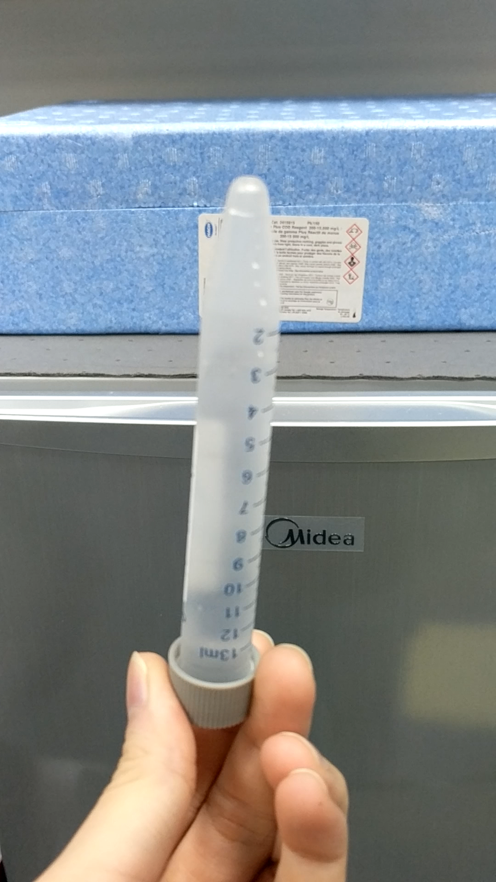
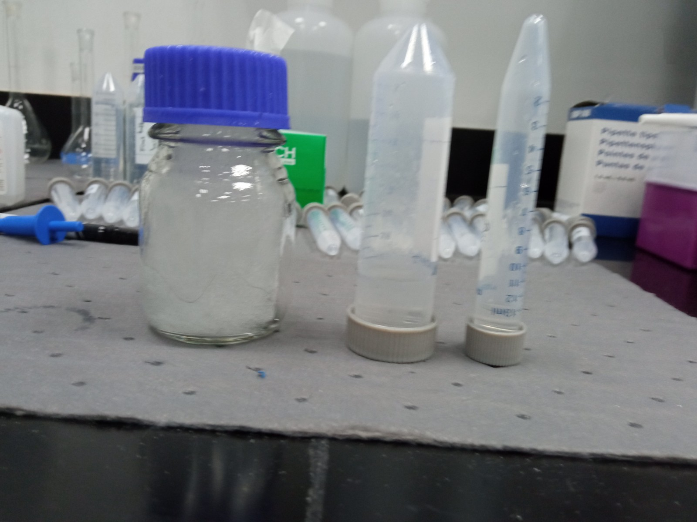
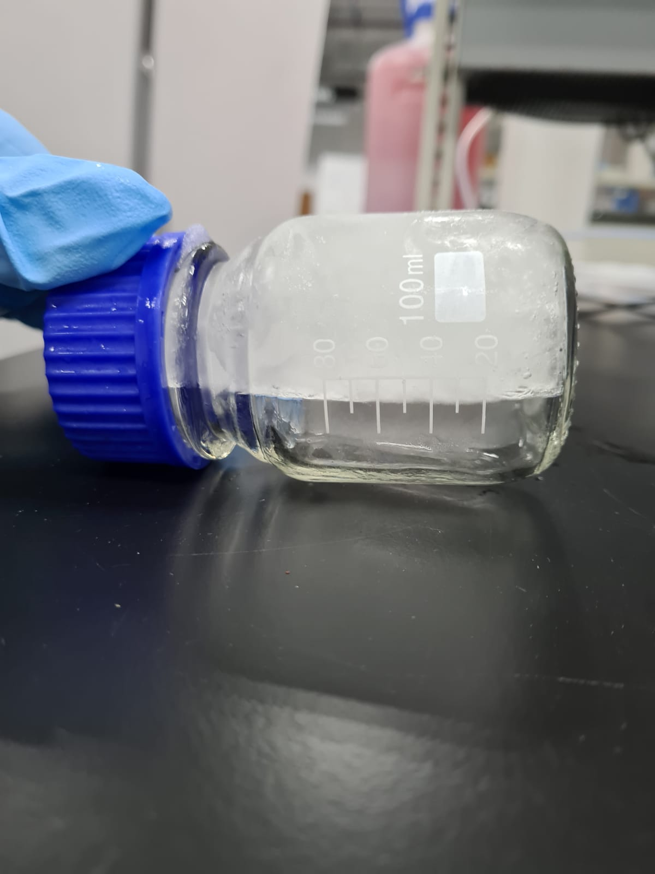
WW sample
ICE + Con. IPA
ICE + Con. IPA
Inlet IPA – 1.5%
Inlet COD- 50000 mg/l
Concentrated IPA > 12.5%
Concentrated IPA COD- 279000 mg/l
Melted ICE: TDS – 172 PPM
Melted ICE IPA > 10 PPM
Lab Freezer study test 1

Slide 9
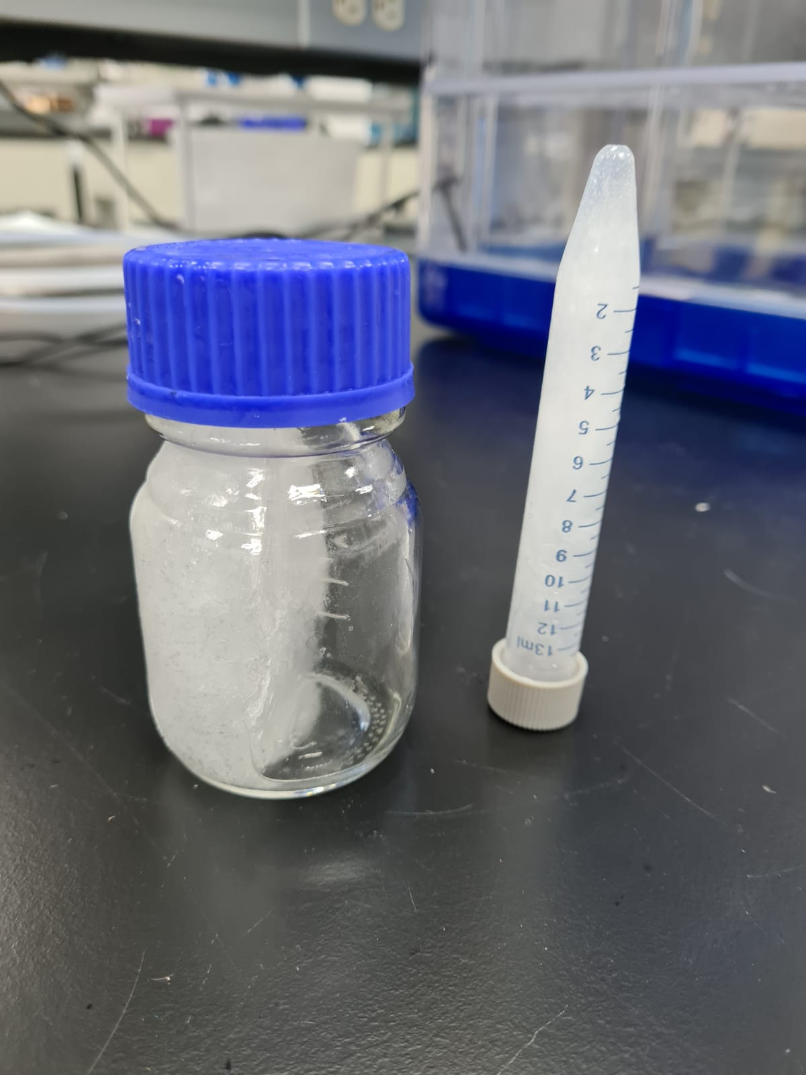
WW sample
ICE + Con. IPA
ICE + Con.IPA
Inlet IPA – 1.5%
Inlet COD- 50000 mg/l
Concentrated IPA >14.8%
Concentrated IPA COD - 320000 PPM
Melted ICE: TDS – 170 PPM
Melted ICE IPA > 10 PPM
Lab Freezer study test 2

Slide 10

THANK YOU

